Slide 1
Decoding Adidas: Unveiling Retail Trends in the United States
Group 7: Ananya Katta, Kirthana Remidi, Sithara Vyapamakula Sreeramachandra,
Sowmya Bobba, Sreenija Kurra, Meera Duvvada

Slide 2

Motivation/
Business Context
The insights derived from adidas sales data play a pivot role in strategic planning and decision making, guiding the company in refining its market strategies, optimizing digital transformation efforts, and maintaining a competitive edge.
Uncovering the trends in e-commerce sales to understand the rapidly evolving digital landscape, and the analysis facilitates the identification of consumer preferences, aiding the development of consumer centric approaches.

Slide 3
Data Description
Source: https://www.kaggle.com/datasets/heemalichaudhari/adidas-sales-dataset
Format : Comma Separated Values(CSV)
Key Variables: (Profit, Sales, Revenue)
Retailer, Retailer ID, Invoice data, Region, State, City, Product gender, Product Style, Product, Price per unit bin, Price per unit, Units sold, Total sales, Operating profit, Operating margin, Sales method.
No of Records: 9644
Data set contains sales for Adidas from December 2020 to December 2021
Data describes the sales for adidas in different region, product style and Product Gender.

Slide 4
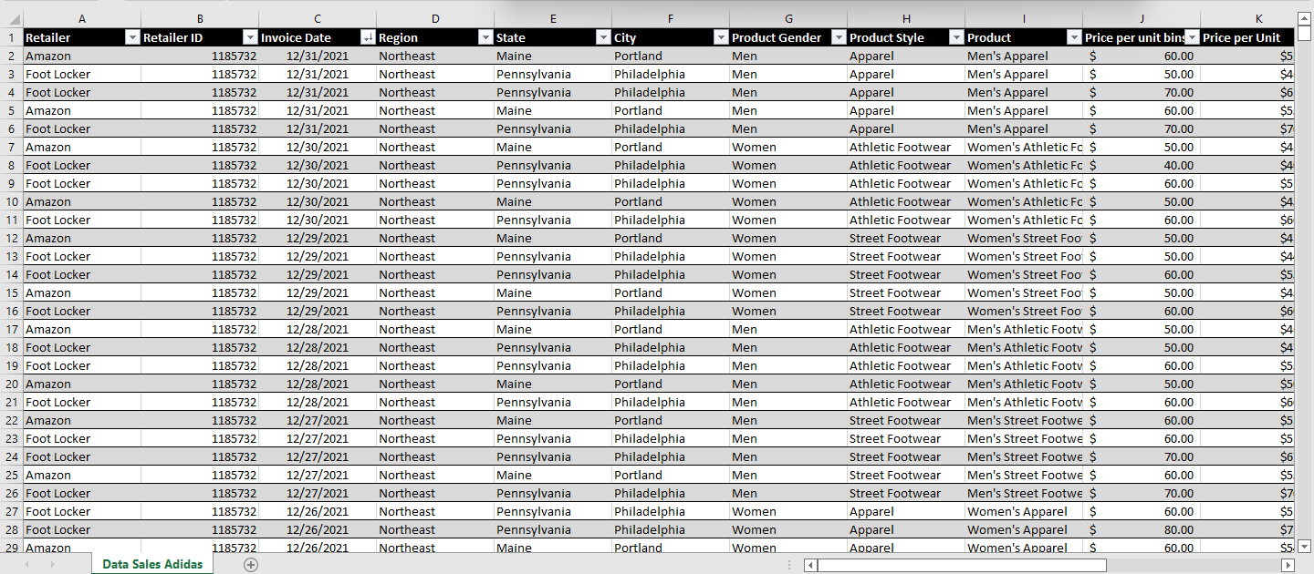
Cleaned Data sheet

Slide 5

Data Preparation
Removed unnecessary information on the datasheet
Removed blank rows and columns in the dataset
Added product style and product gender categories from product category
Created Price per unit category as bin ranges
Added month, quarter and year categories

Slide 6
Research Questions
Kirthana- What is the contribution of each category to overall sales, and are there trends in these contributions over the two-year period?
Sowmya- How do product performance and regional preferences correlate? Are there regions that show a clear preference for specific products?
Meera- Is there a significant difference in the performance of women's product styles compared to men's in terms of total sales and operating profit?
Sithara- To what extent is the method of sales related to operating profit and Operating margin? How are the two related to each other for each method of sales ?
Sreenija- How do retailers perform in relation to their total sales and total units sold? Are there any retailers that consistently excel in both aspects?
Ananya- Is there a correlation between the price per unit and the operating profit for the products sold?

Slide 7


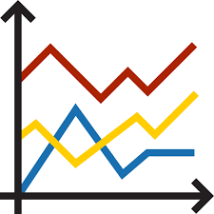


Methodologies Used
Bar chart
Bubble graph
Line graph
Scatter graph
Pie Chart

Slide 8
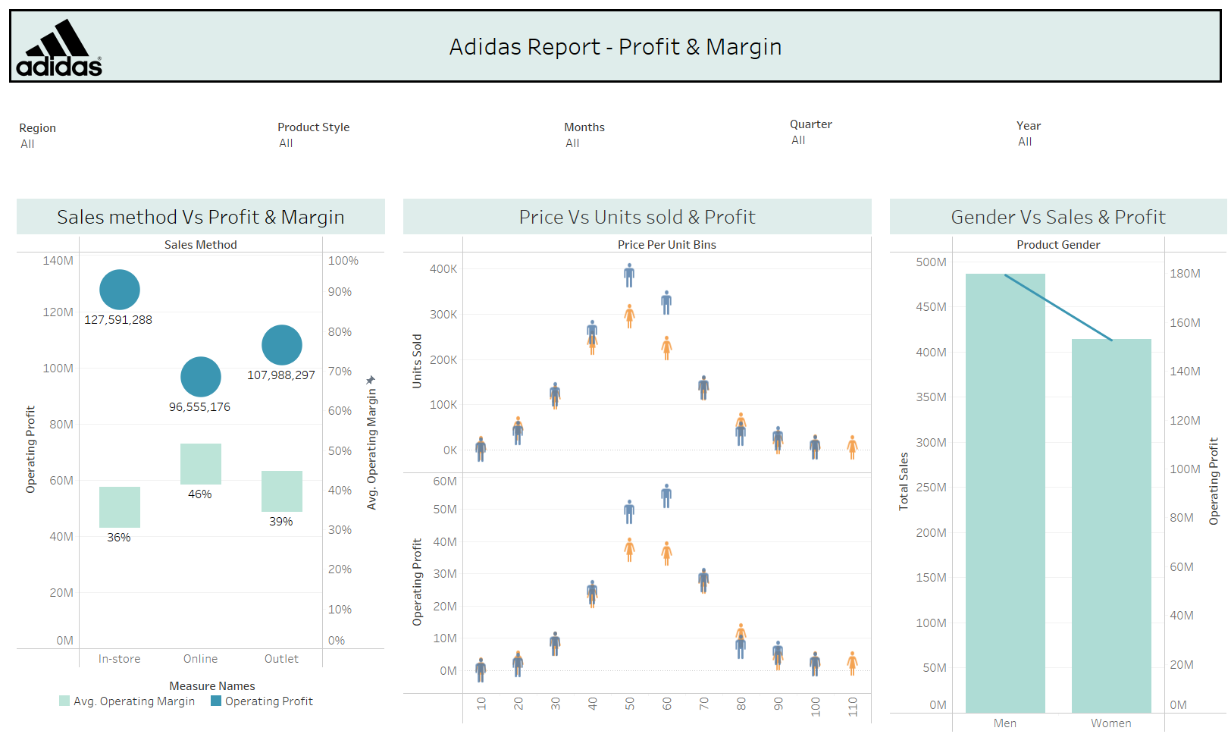
Visualization Dashboard

Slide 9
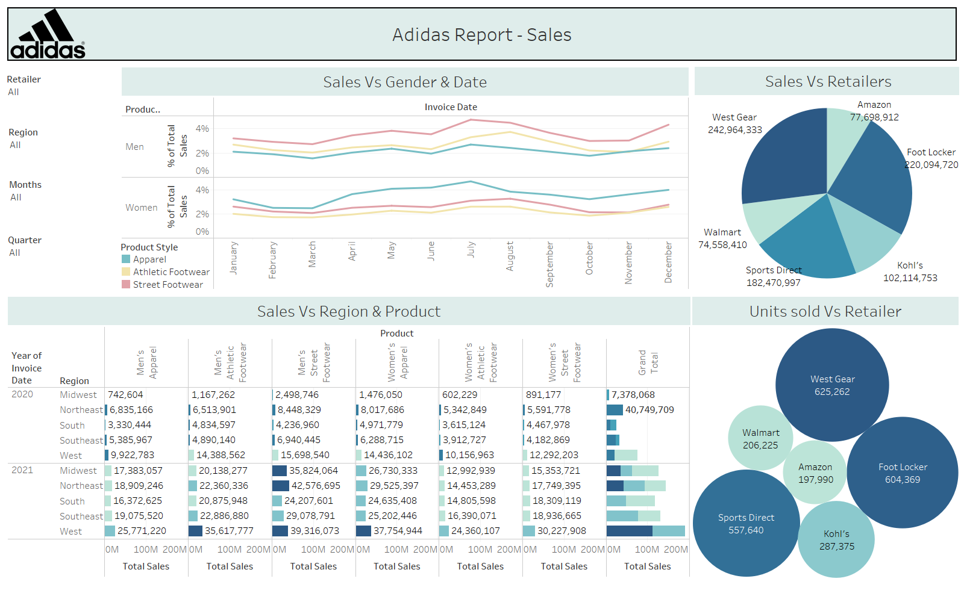
Visualization Dashboard

Slide 10
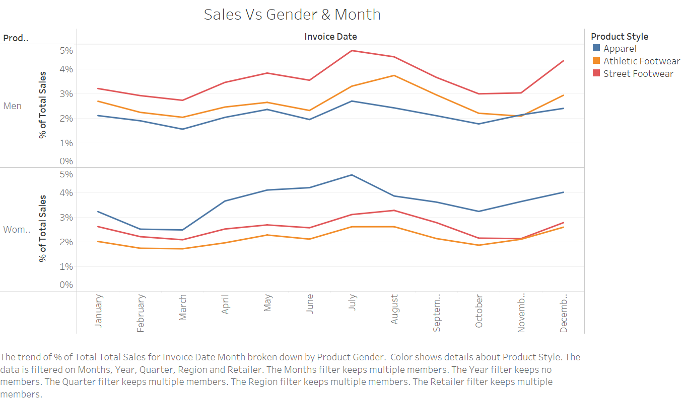
1. Research Analysis
The sales of each product style peaked in the months of july and August among both the gender. Adidas can implement special promotions during black friday to increase sales in November.
The contribution of apparel in women is the highest and least in the men’s category. Adidas can introduce diverse product range in men’s category to cater their needs.
Athletics footwear contribute the least among all the product styles. Adidas can work upon improving their design keeping in mind the looks and comfort.

Slide 11
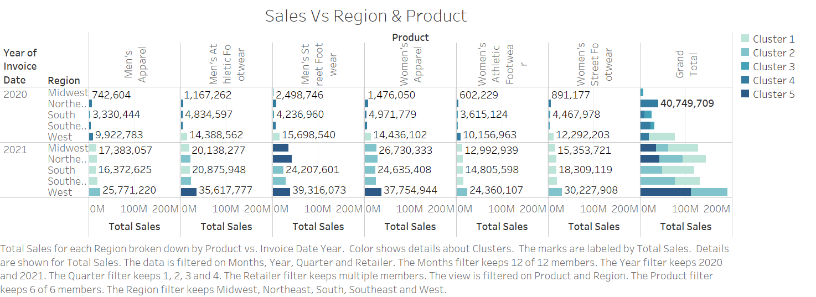
2. Research Analysis
The total sales are high in the West for all product types except for women's apparel, followed by the Northeast. The company can consider investing more in the West and Northeast regions as sales have consistently increased in both years.
Sales have increased by 94% in the Midwest region from 2020 to 2021. While the current strategies have worked well, there is still room for improvement, particularly in increasing sales of women's footwear.
Men's athletic footwear performed poorly in 2020 across all regions except for the West. However, there was a significant improvement in 2021. The company could implement similar strategies to boost sales for women's footwear.

Slide 12
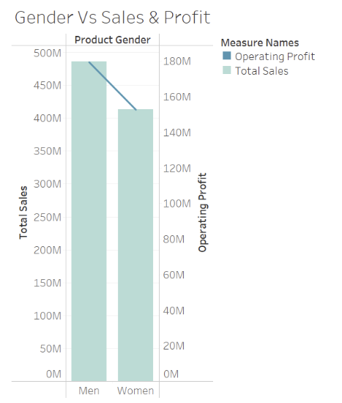
3. Research Analysis
Based on the dual-axis chart , there is indeed a significant difference in the performance of women's products compared to men's products in terms of total sales and operating profit:
Women's products outperforms men's products with a notably higher total sales volume.
The operating profit for men's product is present, but the chart shows that it does not match the high sales volume of women's product. There is a disparity between the sales and the operating profit for women's products, indicating that while sales are higher, this does not translate to proportionately higher operating profits.
In conclusion, women's products shows significantly higher total sales than men's products, but this advantage in sales does not appear to carry over to operating profit with the same magnitude. This suggests that while the market for women's products is strong, it may not be as profitable as men's product, or there may be factors affecting the profit margins of women's product that would require further investigation.
Notes:
Based on the dual-axis chart , there is indeed a significant difference in the performance of women's apparel compared to men's apparel in terms of total sales and operating profit:
Women's apparel outperforms men's apparel with a notably higher total sales volume.
The operating profit for men's apparel is present, but the chart shows that it does not match the high sales volume of women's apparel. There is a disparity between the sales and the operating profit for women's apparel, indicating that while sales are higher, this does not translate to proportionately higher operating profits.
In conclusion, women's apparel shows significantly higher total sales than men's apparel, but this advantage in sales does not appear to carry over to operating profit with the same magnitude. This suggests that while the market for women's apparel is strong, it may not be as profitable as men's apparel, or there may be factors affecting the profit margins of women's apparel that would require further investigation.

Slide 13
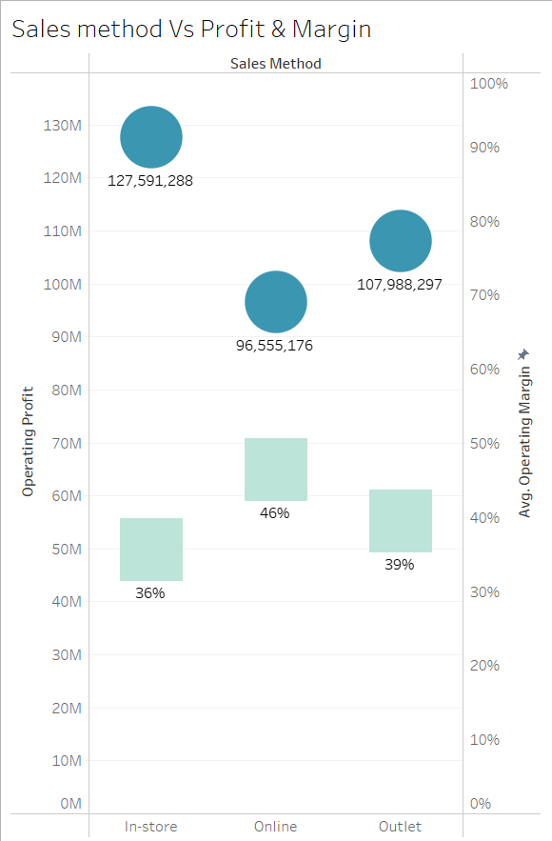

4. Research Analysis
Online sales exhibit a higher average operating margin of 46%, suggesting a more efficient conversion of revenue to operating profit compared to other sales method.
Although online sales have a higher average operating margin, in-store sales lead in terms of the actual operating profit generated.
The efficiency of converting revenue to profit is notable in the online sales channel, as reflected in the higher average operating margin.
The company may explore opportunities to optimize in-store operations to maintain or increase the operating profit, given its significance in overall earnings.
Outlet sales, while providing a respectable operating profit, may benefit from strategies to improve the operating margin.

Slide 14
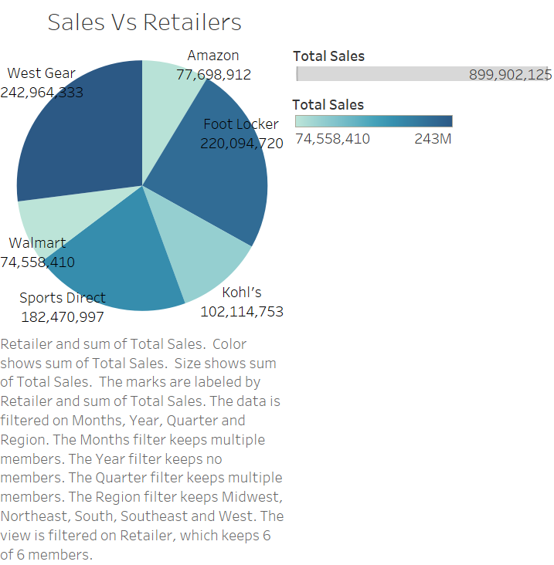
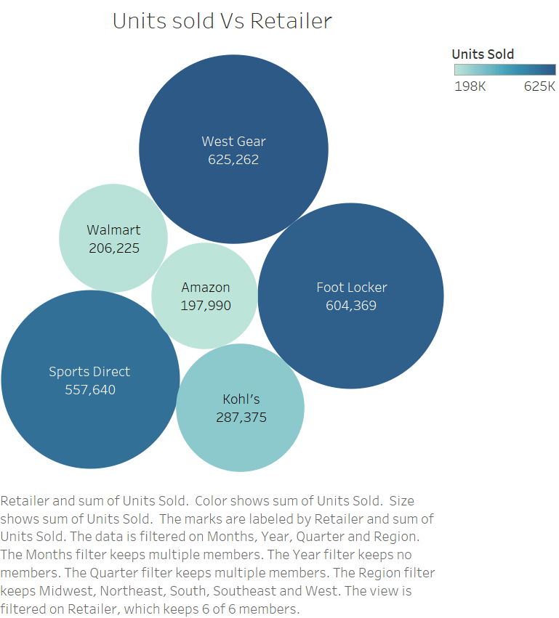
5. Research Analysis
Westgear performed best in terms of total sales, followed by Footlocker.
Westgear performed best in terms of the number of units sold
The total sales and the units sold are directly correlated with each other.
Both Footlocker and Westgear performed better in both total sales and units sold compared to Amazon, Kohl’s, Sports Direct and Walmart.
Sports Direct can increase the price of its products; Amazon and Walmart can increase its sales by increasing the price of its products or units sold.

Slide 15
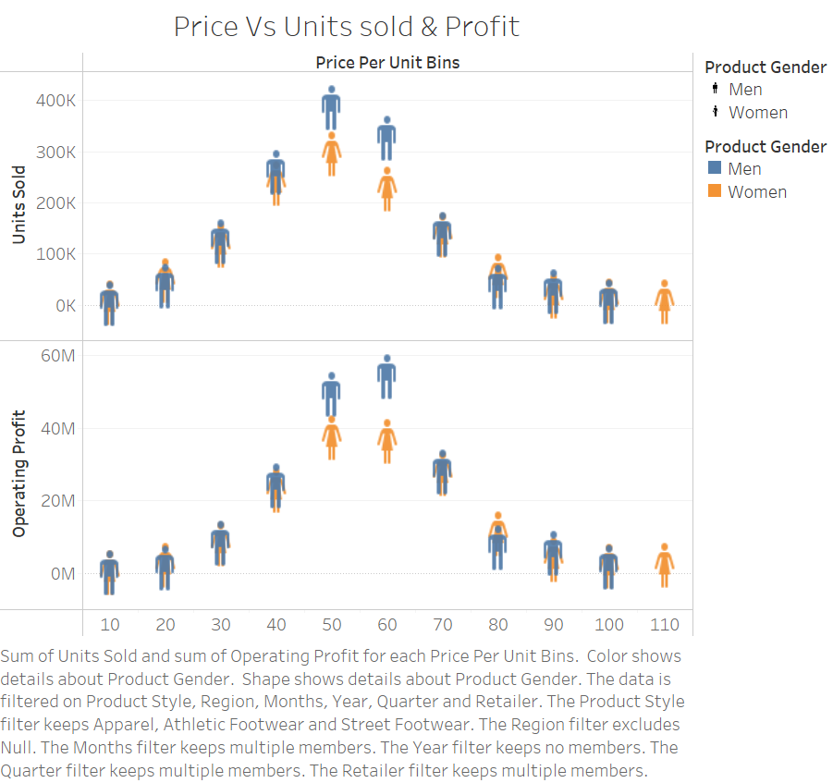
6. Research Analysis
This visualization depicts a comparison between the price per unit and the corresponding values of operating profit and units sold. And both of them follow a normal distribution curve.
Mid-priced products exhibit superior operating profits compared to both low and high-priced units.
Operating Profit trend aligns with the corresponding volume of units sold.
The data suggests that overall profit is primarily dependent on the quantity of units sold rather than achieving a higher profit margin per individual unit.
Mostly women tend to have almost equal or less operating profit than men for the same price range . Therefore they can concentrate on improving operating profit and units sold in womens products.

Slide 16
Key Takeaways
Initially, the dataset had a lot of duplicate rows and null values. Modified the data by adding new column that categorizes product into product styles, product gender which helps in drawing valuable insights from the data
Used totals and clusters for analyzing the data and creating useful insights. Built aggregate functions for creating visualizations.
Explored the diverse features and capabilities of Tableau, delving into its functionalities to gain a comprehensive understanding. Subsequently, applied this knowledge to craft dashboards that go beyond mere visuals, aiming to convey insightful and meaningful information
Developed teamwork skills, collaborating effectively in group settings, contributing to shared goals, and adapting to diverse working styles.
Learnt about profits, sales, and retail analysis to provide useful insights.
Gained diverse insights by trying column combinations. This flexibility in grouping and presenting data reveals unique patterns and trends, enhancing comprehensive understanding and analysis.

